Slide 1
Clustering
Prof. Navneet Goyal
BITS, Pilani
Notes:
Dr. Navneet Goyal, BITS,Pilani

Slide 2
What is Cluster Analysis?
Finding groups of objects such that the objects in a group will be similar (or related) to one another and different from (or unrelated to) the objects in other groups
Inter-cluster distances are maximized
Intra-cluster distances are minimized
Source of figure: unknown
Notes:
Dr. Navneet Goyal, BITS,Pilani

Slide 3
Clustering
Clustering of data is a method by which large sets of data is grouped into clusters of smaller sets of similar data
Objects in one cluster have high similarity to each other and are dissimilar to objects in other clusters
An example of unsupervised learning
Group objects that share common characteristics
Notes:
Dr. Navneet Goyal, BITS,Pilani

Slide 4
Clustering Applications
Segment customer database based on similar buying patterns.
Group houses in a town into neighborhoods based on similar features.
Identify new plant species
Identify similar Web usage patterns
Notes:
Dr. Navneet Goyal, BITS,Pilani

Slide 5
Clustering Applications
Marketing: Help marketers discover distinct groups in their customer bases, and then use this knowledge to develop targeted marketing programs
Land use: Identification of areas of similar land use in an earth observation database
Insurance: Identifying groups of motor insurance policy holders with a high average claim cost
City-planning: Identifying groups of houses according to their house type, value, and geographical location
Earth-quake studies: Observed earth quake epicenters should be clustered along continent faults
Notes:
Dr. Navneet Goyal, BITS,Pilani

Slide 6
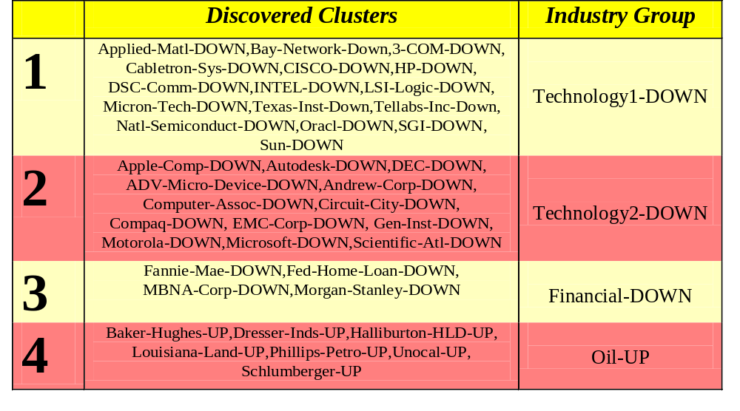
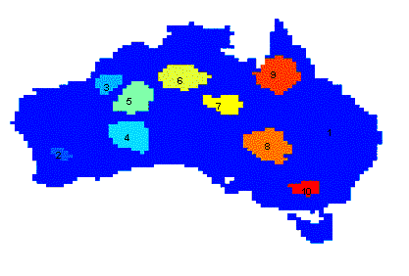
Applications of Cluster Analysis
Understanding
  Group related documents for browsing, group genes and proteins that have similar functionality, or group stocks with similar price fluctuations
Summarization
  Reduce the size of large data sets
Clustering precipitation in Australia
Notes:
Dr. Navneet Goyal, BITS,Pilani

Slide 7
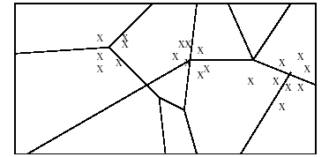
Applications of Cluster Analysis
Many years ago, during a cholera outbreak in London, a physician plotted the location of cases on amap, getting a plot that looked like Fig. 14. Properly visualized, the data indicated that cases clustered around certain intersections, where there were polluted wells, not only exposing the cause of cholera, but indicating what to do about the problem. Alas, not all data mining is this easy, often because the clusters are in so many dimensions that visualization is very hard.
Notes:
Dr. Navneet Goyal, BITS,Pilani

Slide 8
Applications of Cluster Analysis
Skycat clustered 2x10⁹ sky objects into stars, galaxies, quasars, etc. Each object was a point in aspace of 7 dimensions, with each dimension representing radiation in one band of the spectrum. The Sloan Sky Survey is a more ambitious attempt to catalog and cluster the entire visible universe.
Documents may be thought of as points in a high-dimensional space, where each dimension corresponds to one possible word. The position of a document in a dimension is the number of times the word occurs in the document (or just 1 if it occurs, 0 if not). Clusters of documents in this space often correspond to groups of documents on the same topic.
Notes:
Dr. Navneet Goyal, BITS,Pilani

Slide 9
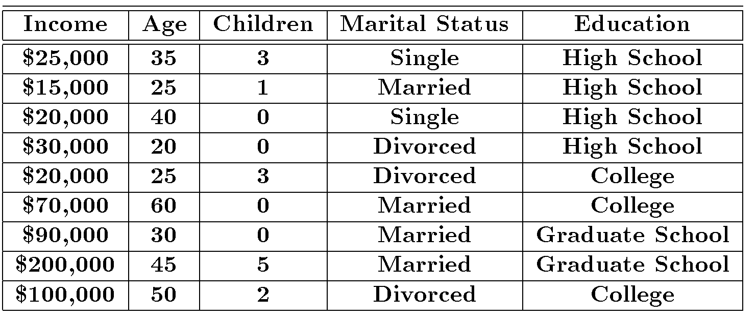
Clustering Example
Source: Data Mining by Dunham, M H
Notes:
Dr. Navneet Goyal, BITS,Pilani

Slide 10
Clustering Houses
Geographic Distance Based
Size Based
Source of figure: Data Mining by Dunham, M H
Notes:
Dr. Navneet Goyal, BITS,Pilani

Slide 11
Notion of a Cluster can be Ambiguous
How many clusters?
Six Clusters
Two Clusters
Four Clusters
Source of figure: Introduction to Data Mining by Tan et. al.
Notes:
Dr. Navneet Goyal, BITS,Pilani

Slide 12
Clustering vs. Classification
No prior knowledge
  Number of clusters
  Meaning/interpretation of clusters
Unsupervised learning
Notes:
Dr. Navneet Goyal, BITS,Pilani

Slide 13
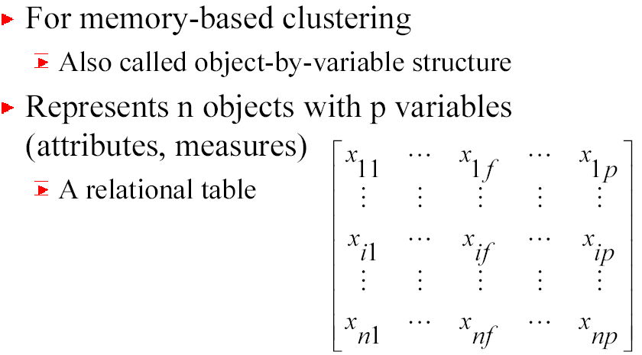
Types of Data in Cluster Analysis
Data matrix
Notes:
Dr. Navneet Goyal, BITS,Pilani

Slide 14
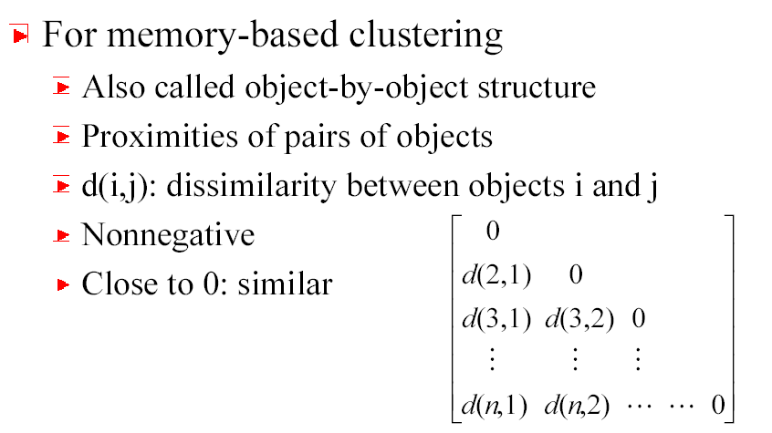
Types of Data in Cluster Analysis
Dissimilarity Matrix
Notes:
Dr. Navneet Goyal, BITS,Pilani

Slide 15
Dissimilarity Matrix
Many clustering algorithms operate on dissimilarity matrix
If data matrix is given, it needs to be transformed into a dissimilarity matrix first
How can we assess dissimilarity d(i,j)?
Notes:
Dr. Navneet Goyal, BITS,Pilani

Slide 16
Types of Data
Interval-scaled variables
Binary variables
Nominal, ordinal, and ratio variables
Variables of mixed types
Notes:
Dr. Navneet Goyal, BITS,Pilani

Slide 17
Interval-scaled Variables
Continuous measurements of a roughly linear scale
Weight, height, latitude and longitude coordinates, temperature, etc.
Effect of measurement units in attributes
    Smaller unit Larger variable range Larger effect to the clustering structure
Standardization + background knowledge
Clustering BB player may require giving more weightage to height
Notes:
Dr. Navneet Goyal, BITS,Pilani

Slide 18


Standardizing Variables
Standardize data
  Calculate the mean absolute deviation:
  where
  Calculate the standardized measurement (z-score)
Using mean absolute deviation is more robust than using standard deviation as z-scores of outliers do not become too small and so they remain detectable
Notes:
Dr. Navneet Goyal, BITS,Pilani

Slide 19
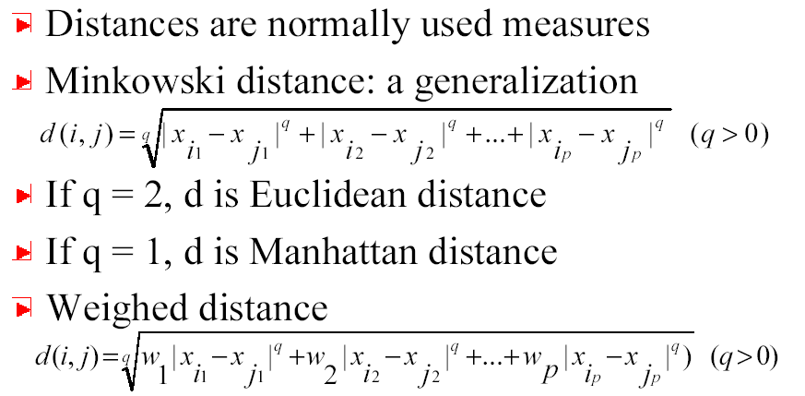
Similarity & dissimilarity between Objects
Notes:
Dr. Navneet Goyal, BITS,Pilani

Slide 20
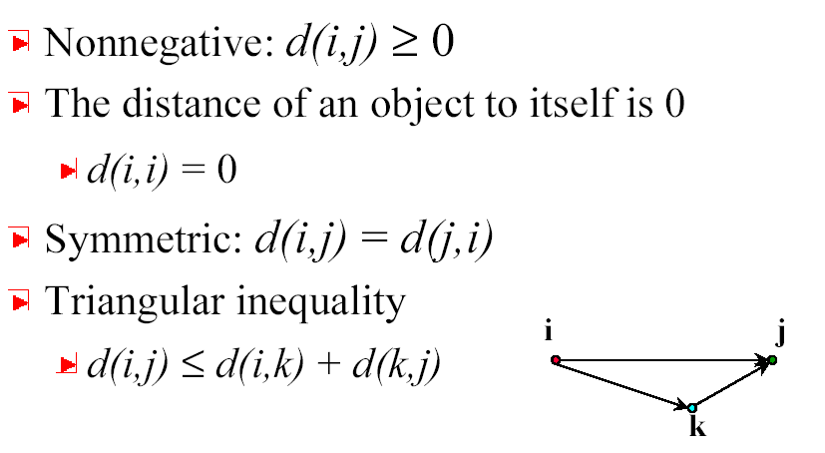
Properties of Minkowski Distance
Notes:
Dr. Navneet Goyal, BITS,Pilani

Slide 21



Binary Variables
A contingency table for binary data
Simple matching coefficient (invariant, if the binary variable is symmetric):
Jaccard coefficient (noninvariant if the binary variable is asymmetric):
Object j
Object i
Notes:
Dr. Navneet Goyal, BITS,Pilani

Slide 22


Dissimilarity between Binary Variables
Example
  gender is a symmetric attribute
  the remaining attributes are asymmetric binary
  let the values Y and P be set to 1, and the value N be set to 0
Notes:
Dr. Navneet Goyal, BITS,Pilani

Slide 23

Nominal Variables
A generalization of the binary variable in that it can take more than 2 states, e.g., red, yellow, blue, green
Method 1: Simple matching
  m: # of matches, p: total # of variables
Method 2: use a large number of binary variables
  creating a new binary variable for each of the M nominal states
Notes:
Dr. Navneet Goyal, BITS,Pilani

Slide 24


Ordinal Variables
An ordinal variable can be discrete or continuous
order is important, e.g., rank
Can be treated like interval-scaled
  replacing x_{if} by their rank
  map the range of each variable onto [0, 1] by replacing i-th object in the f-th variable by
  compute the dissimilarity using methods for interval-scaled variables
Notes:
Dr. Navneet Goyal, BITS,Pilani

Slide 25
Ratio-Scaled Variables
Ratio-scaled variable: a positive measurement on a nonlinear scale, approximately at exponential scale, such as Ae^{Bt} or Ae^{-Bt}
Methods:
  treat them like interval-scaled variables — not a good choice! (why?)
  apply logarithmic transformation
y_{if} = log(x_{if})
  treat them as continuous ordinal data treat their rank as interval-scaled.
Notes:
Dr. Navneet Goyal, BITS,Pilani

Slide 26


Variables of Mixed Types
A database may contain all the six types of variables
  symmetric binary, asymmetric binary, nominal, ordinal, interval and ratio.
One may use a weighted formula to combine their effects.
  f is binary or nominal:
    d_{ij}^{(f)} = 0 if x_{if} = x_{jf} , or d_{ij}^{(f)} = 1 o.w.
  f is interval-based: use the normalized distance
  f is ordinal or ratio-scaled
    compute ranks r_{if} and
    and treat z_{if} as interval-scaled
Notes:
Dr. Navneet Goyal, BITS,Pilani

Slide 27
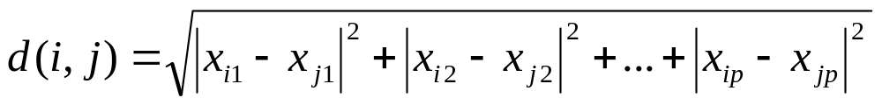
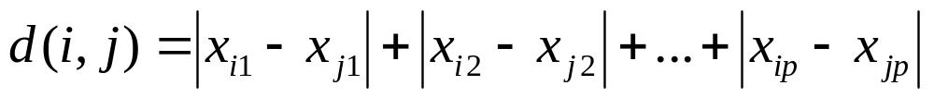
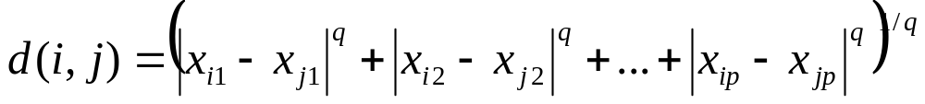
Similarity Measures
If i = (x_{i1}, x_{i2}, …, x_{ip},) and j = (x_{j1}, x_{j2}, …, x_{jp}) are two p-dimensional data objects, then
Euclidean distance
Manhattan distance
Minkowski distance
Notes:
Dr. Navneet Goyal, BITS,Pilani

Slide 28
What Is Good Clustering?
A good clustering method will produce high quality clusters with
  high intra-class similarity
  low inter-class similarity
The quality of a clustering result depends on both the similarity measure used by the method and its implementation.
The quality of a clustering method is also measured by its ability to discover some or all of the hidden patterns.
Notes:
Dr. Navneet Goyal, BITS,Pilani

Slide 29
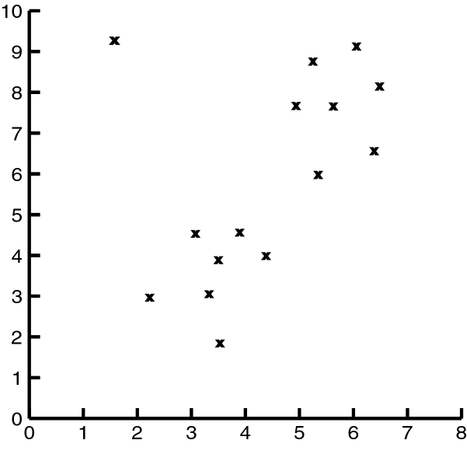
Impact of Outliers on Clustering
Source of figure: Data Mining by Dunham, M H
Notes:
Dr. Navneet Goyal, BITS,Pilani

Slide 30
Problems with Outliers
Many clustering algorithms take as input the number of clusters
Some clustering algorithms find and eliminate outliers
Statistical techniques to detect outliers
Discordancy Test
Not very realistic for real life data
Notes:
Dr. Navneet Goyal, BITS,Pilani

Slide 31
Clustering Problem
Given a database D={t₁,t₂,…,t_{n}} of tuples and an integer value k, the Clustering Problem is to define a mapping f:D{1,..,k} where each t_{i} is assigned to one cluster K_{j}, 1<=j<=k.
A Cluster, K_{j}, contains precisely those tuples mapped to it.
Unlike classification problem, clusters are not known a priori.
Notes:
Dr. Navneet Goyal, BITS,Pilani

Slide 32
Clustering Approaches
Clustering
Hierarchical
Partitional
Density-based
Grid-based
Notes:
Dr. Navneet Goyal, BITS,Pilani

Slide 33
Clustering Algorithms
K-means and its variants
Hierarchical clustering
Density-based clustering
Notes:
Dr. Navneet Goyal, BITS,Pilani

Slide 34
Types of Clusterings
Important distinction between hierarchical and partitional sets of clusters
Partitional Clustering
  A division of data objects into non-overlapping subsets (clusters) such that each data object is in exactly one subset
Hierarchical clustering
  A set of nested clusters organized as a hierarchical tree
Notes:
Dr. Navneet Goyal, BITS,Pilani

Slide 35

Partitional Clustering
Original Points
A Partitional Clustering
Iterative
K-means, K-medoids
Notes:
Dr. Navneet Goyal, BITS,Pilani

Slide 36
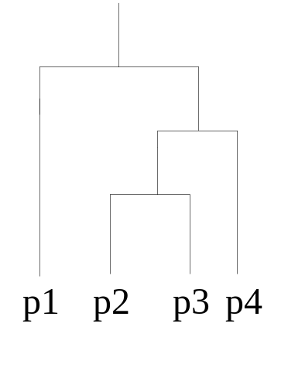
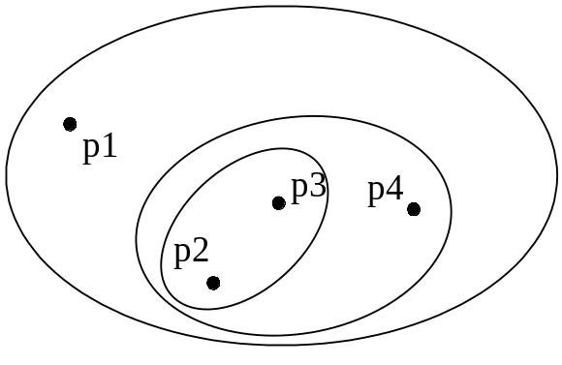
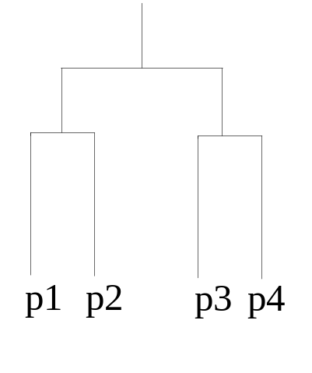
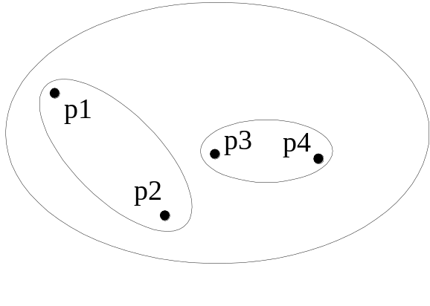
Hierarchical Clustering
Traditional Hierarchical Clustering
Traditional Dendrogram
Non-traditional Hierarchical Clustering
Non-traditional Dendrogram
Notes:
Dr. Navneet Goyal, BITS,Pilani

Slide 37
Hierarchical Methods
Creates a hierarchical decomposition of a given set of data objects
Agglomerative
  Initially each item in its own cluster
  Clusters are merged iteratively
  Bottom up
Divisive
  Initially all items in one cluster
  Large clusters are divided successively
  Top down
Notes:
Dr. Navneet Goyal, BITS,Pilani

Slide 38
Hierarchical Clustering
Step 0
Step 1
Step 2
Step 3
Step 4
agglomerative
(AGNES)
a
a b
b
a b c d e
c
c d e
d
d e
e
divisive
(DIANA)
Step 4
Step 3
Step 2
Step 1
Step 0
Notes:
Dr. Navneet Goyal, BITS,Pilani

Slide 39


Hierarchical Clustering
Produces a set of nested clusters organized as a hierarchical tree
Can be visualized as a “dendrogram”
  A tree like diagram that records the sequences of merges or splits
Notes:
Dr. Navneet Goyal, BITS,Pilani

Slide 40
Density-based Methods
Most partitioning-based methods cluster objects based on distances between them
Can find only spherical-shaped clusters
Density-based clustering
Continue growing a given cluster as long as the density in the ‘neighborhood’ exceeds some threshold.
Notes:
Dr. Navneet Goyal, BITS,Pilani

Slide 41
Hierarchical Algorithms
Single Link (MIN)
MST Single Link
Complete Link (MAX)
Average Link (Group Average)
Notes:
Dr. Navneet Goyal, BITS,Pilani

Slide 42
Partitioning Algorithms:
Basic Concept
Partitioning method: Construct a partition of a database D of n objects into a set of k clusters
Given a k, find a partition of k clusters that optimizes the chosen partitioning criterion
  Global optimal: exhaustively enumerate all partitions
  Heuristic methods: k-means and k-medoids algorithms
    k-means (MacQueen’67): Each cluster is represented by the center of the cluster
    k-medoids or PAM (Partition around medoids) (Kaufman & Rousseeuw’87): Each cluster is represented by one of the objects in the cluster
Notes:
Dr. Navneet Goyal, BITS,Pilani

Slide 43
K-means
Works when we know k, the number of clusters we want to find
Idea:
  Randomly pick k points as the “centroids” of the k clusters
  Loop:
    For each point, put the point in the cluster to whose centroid it is closest
    Recompute the cluster centroids
    Repeat loop (until there is no change in clusters between two consecutive iterations.)
Iterative improvement of the objective function:
Sum of the squared distance from each point to the centroid of its cluster
Notes:
Dr. Navneet Goyal, BITS,Pilani

Slide 44
K-means Example
For simplicity, 1-dimension objects and k=2.
  Numerical difference is used as the distance
Objects: 1, 2, 5, 6,7
K-means:
  Randomly select 5 and 6 as centroids;
  => Two clusters {1,2,5} and {6,7}; meanC1=8/3, meanC2=6.5
  => {1,2}, {5,6,7}; meanC1=1.5, meanC2=6
  => no change.
  Aggregate dissimilarity
    (sum of squares of distance of each point of each cluster from its cluster center--(intra-cluster distance)
  = 0.5²+ 0.5²+ 1²+ 0²+1² = 2.5
|1-1.5|²
Notes:
Dr. Navneet Goyal, BITS,Pilani

Slide 45
K-Means Example
Given: {2,4,10,12,3,20,30,11,25}, k=2
Randomly choose seeds: m₁=3,m₂=4
K₁={2,3}, K₂={4,10,12,20,30,11,25}, m₁=2.5,m₂=16
K₁={2,3,4},K₂={10,12,20,30,11,25}, m₁=3,m₂=18
K₁={2,3,4,10},K₂={12,20,30,11,25}, m₁=4.75,m₂=19.6
K₁={2,3,4,10,11,12},K₂={20,30,25}, m₁=7,m₂=25
Stop as the clusters with these means are the same
Notes:
Dr. Navneet Goyal, BITS,Pilani

Slide 46
K Means Example
(K=2)
Pick seeds
Reassign clusters
Compute centroids
Reasssign clusters
x
x
x
Compute centroids
x
x
x
Reassign clusters
Converged!
[From Mooney]
Notes:
Dr. Navneet Goyal, BITS,Pilani

Slide 47
Pros & Cons of K-means
Relatively efficient: O(tkn)
n: # objects, k: # clusters, t: # iterations; k, t << n.
Applicable only when mean is defined
What about categorical data?
Need to specify the number of clusters
Unable to handle noisy data and outliers
Notes:
Dr. Navneet Goyal, BITS,Pilani

Slide 48

Problems with K-means
Need to know k in advance
  Could try out several k?
    Unfortunately, cluster tightness increases with increasing K. The best intra-cluster tightness occurs when k=n (every point in its own cluster)
Tends to go to local minima that are sensitive to the starting centroids
  Try out multiple starting points
Disjoint and exhaustive
  Doesn’t have a notion of “outliers”
    Outlier problem can be handled by K-medoid or neighborhood-based algorithms
Assumes clusters are spherical in vector space
  Sensitive to coordinate changes, weighting etc.
Example showing
sensitivity to seeds
In the above, if you start
with B and E as centroids
you converge to {A,B,C}
and {D,E,F}
If you start with D and F
you converge to
{A,B,D,E} {C,F}
Notes:
Dr. Navneet Goyal, BITS,Pilani

Slide 49
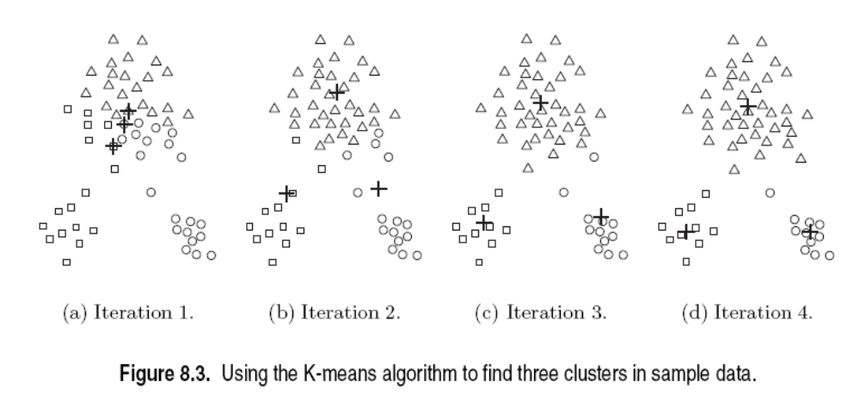
Good Initial Centroids
Source of figure: Introduction to Data Mining by Tan et. al.

Slide 50
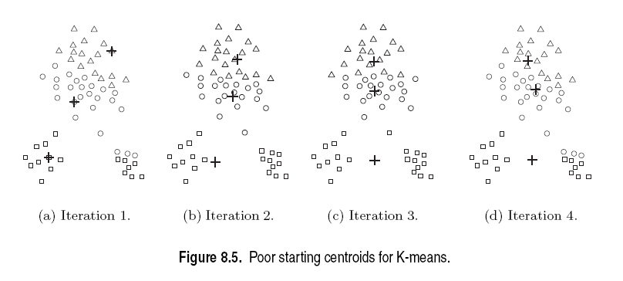
Poor Initial Centroids
Source of figure: Introduction to Data Mining by Tan et. al.

Slide 51
Limitations of K-means
K-means has problems when clusters are of differing
  Sizes
  Densities
  Non-globular shapes
Empty clusters
K-means has problems when the data contains outliers.

Slide 52
Choosing Initial Centroids
Random Initialization
  Perform multiple runs with randomly chosen initial seeds
  Choose the set of clusters with minimum SSE
  Not necessarily a good solution
Sampling
  Sample and do hierarchical clustering
  K clusters are found
  Centroids of these clusters are used as initial seeds
  Works well only if
    Sample is relatively small (few 100_{s} to few 1000_{s})
    K<<sample size

Slide 53
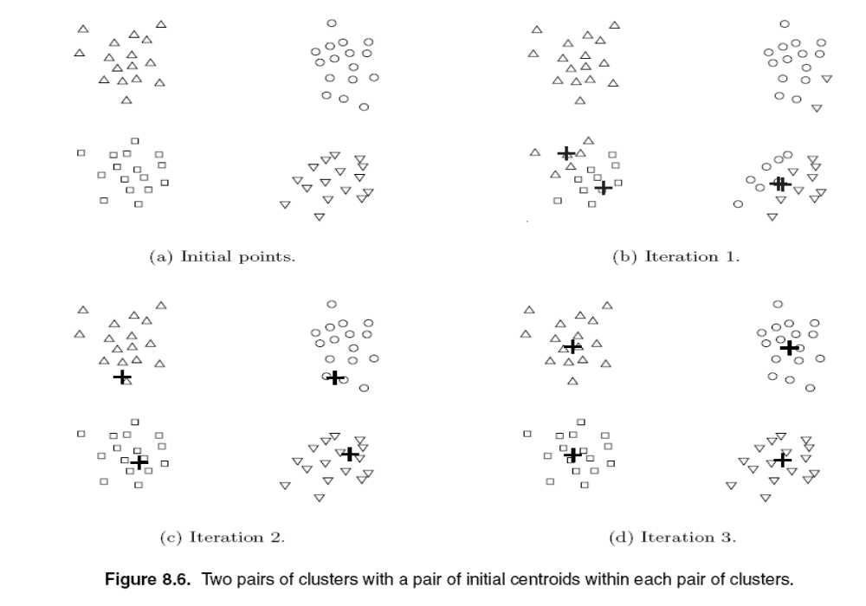
Choosing Initial Centroids
Source of figure: Introduction to Data Mining by Tan et. al.

Slide 54
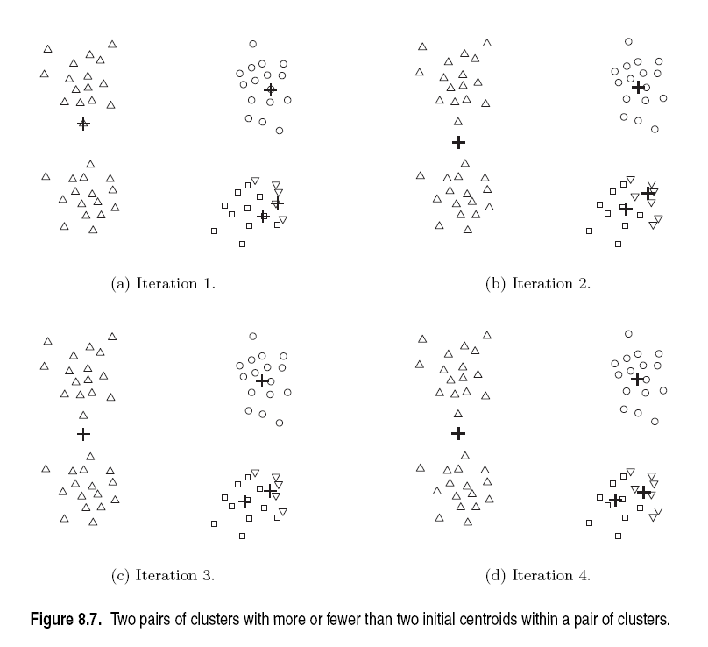
Choosing Initial Centroids
Source of figure: Introduction to Data Mining by Tan et. al.

Slide 55
Poor Initial Centroids
Source of figure: Introduction to Data Mining by Tan et. al.

Slide 56
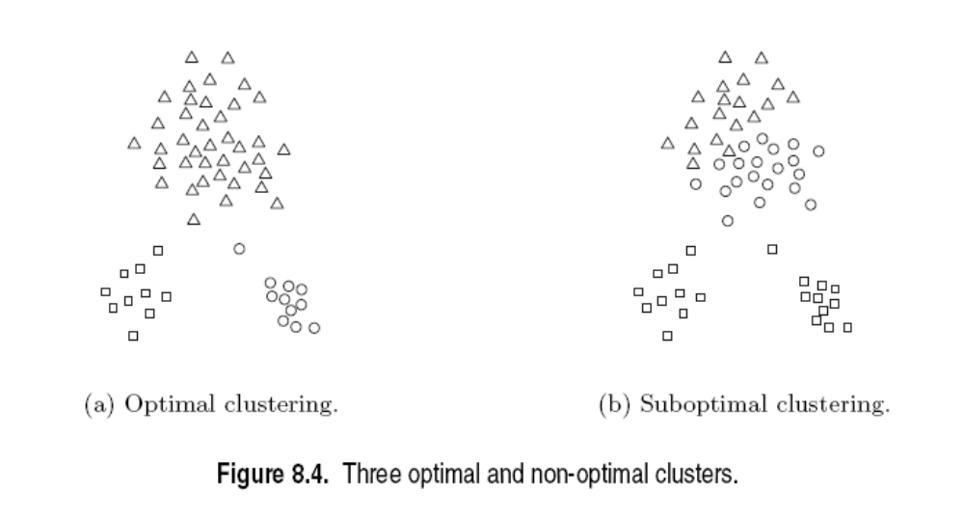
Poor Initial Centroids
Source of figure: Introduction to Data Mining by Tan et. al.

Slide 57
Variations on K-means
Recompute the centroid after every (or few) changes (rather than after all the points are re-assigned)
  Improves convergence speed
Starting centroids (seeds) change which local minima we converge to, as well as the rate of convergence
  Use heuristics to pick good seeds
    Can use another cheap clustering over random sample
  Run K-means M times and pick the best clustering that results
    Bisecting K-means takes this idea further…
Lowest aggregate
Dissimilarity
(intra-cluster
distance)
Notes:
Dr. Navneet Goyal, BITS,Pilani

Slide 58

Bisecting K-means
Bisecting K-means algorithm
  Variant of K-means that can produce a partitional or a hierarchical clustering

Slide 59
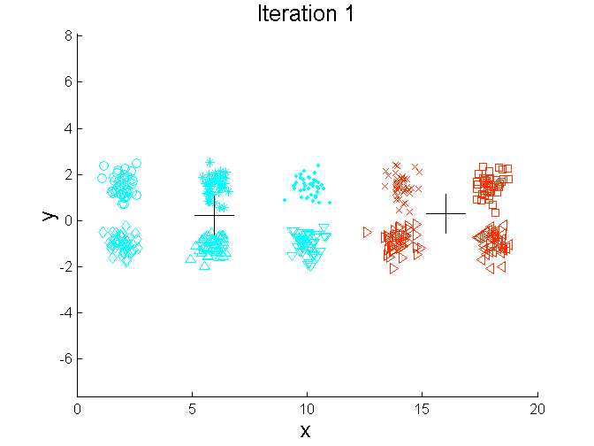
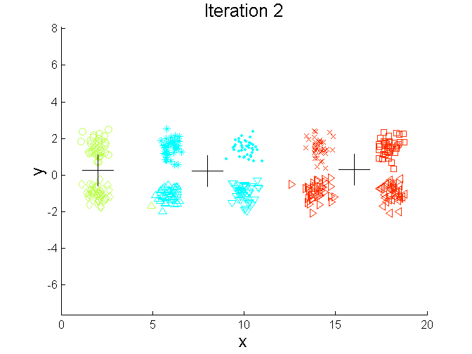
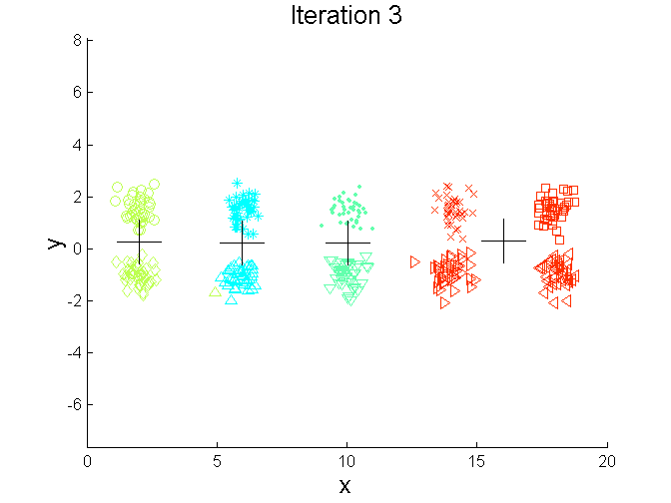
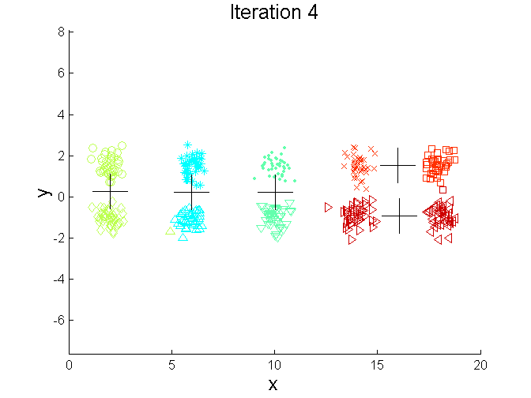
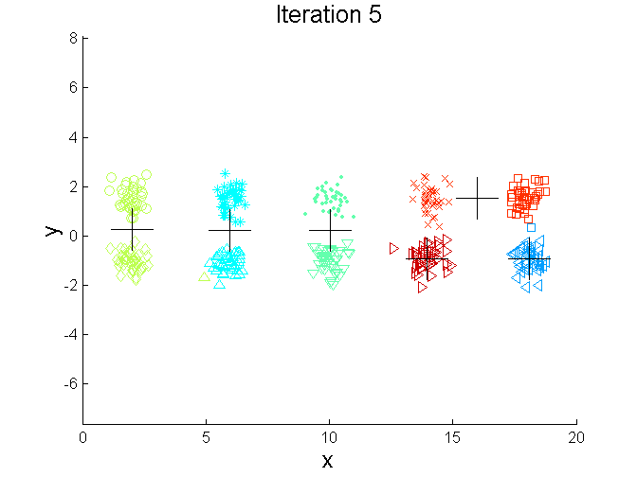
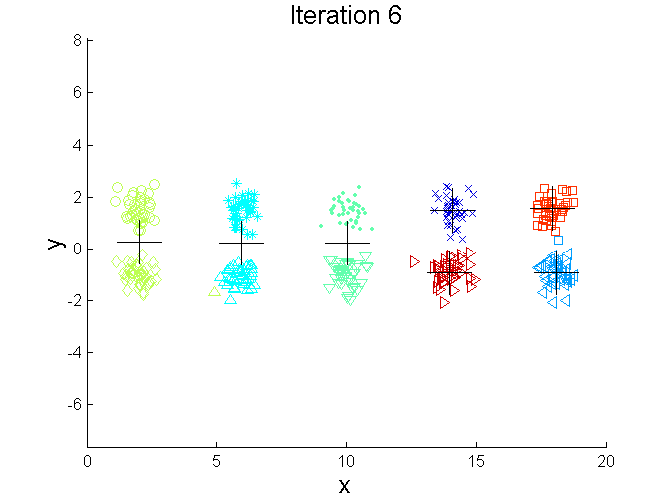
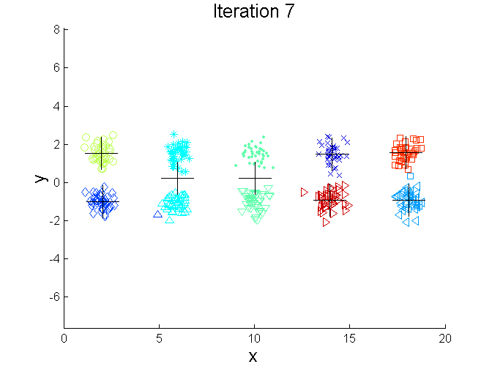
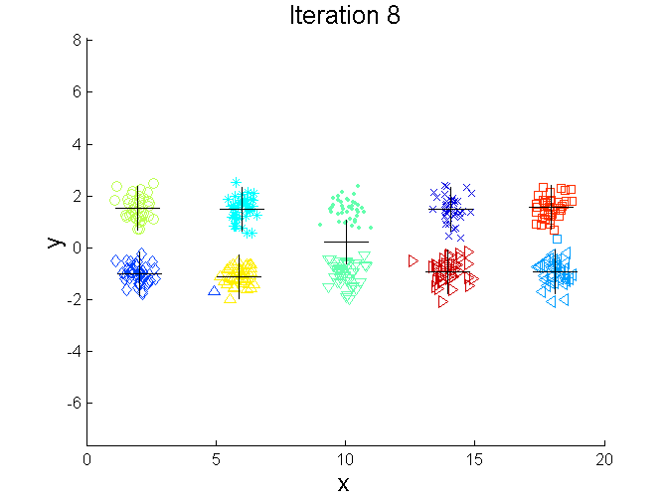
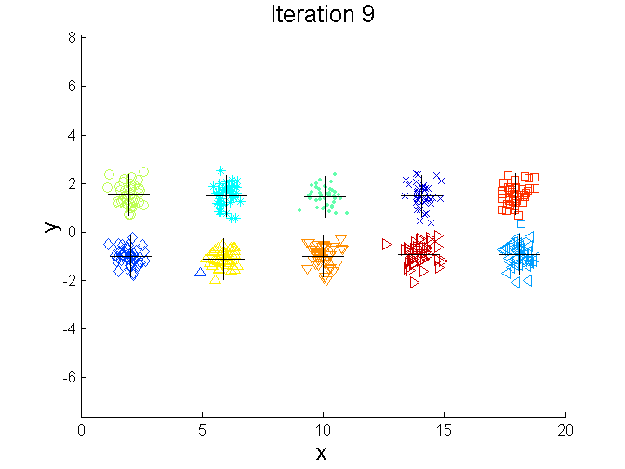
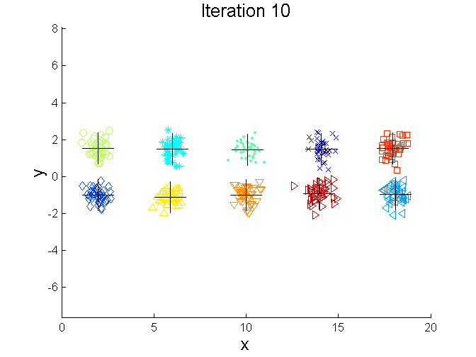
Bisecting K-means Example
Source of figure: Introduction to Data Mining by Tan et. al.

Slide 60
Bisecting K-means
Can pick the largest
Cluster or the cluster
With lowest average
similarity
For I=1 to k-1 do{
  Pick a leaf cluster C to split
  For J=1 to ITER do{
    Use K-means to split C into two sub-clusters, C₁ and C₂
    Choose the best of the above splits and make it permanent}
  }
Divisive hierarchical clustering method
uses K-means
Notes:
Dr. Navneet Goyal, BITS,Pilani

Slide 61
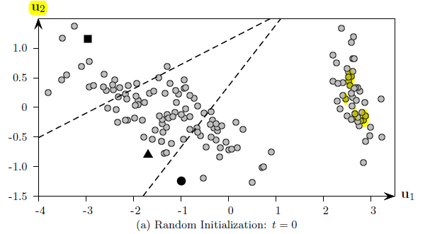
K-Means
Figure taken from book by M J Zaki on Data Mining Analysis

Slide 62
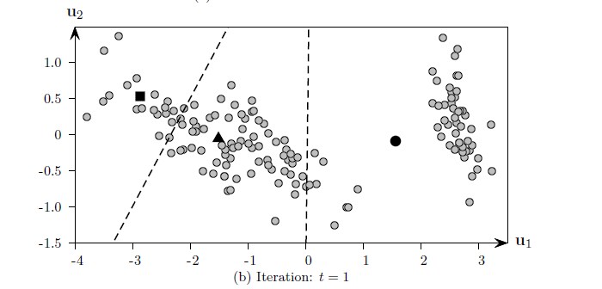
K-Means
Figure taken from book by M J Zaki on Data Mining Analysis

Slide 63
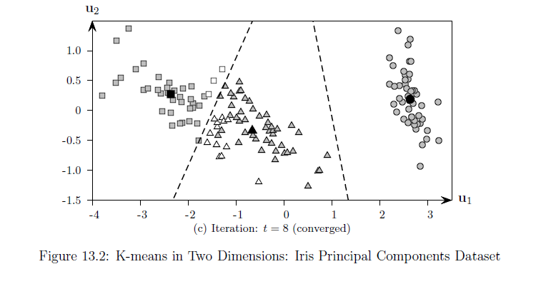
K-Means
Figure taken from book by M J Zaki on Data Mining Analysis

Slide 64
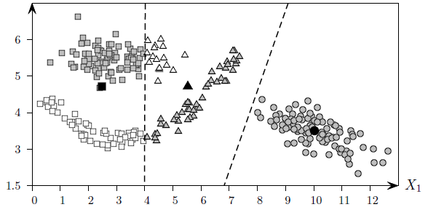
K-Means
Figure taken from book by M J Zaki on Data Mining Analysis

Slide 65
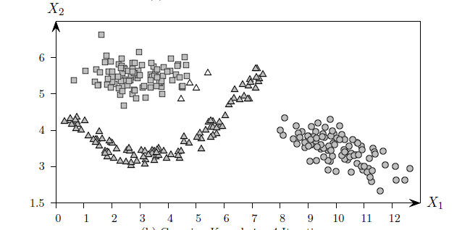
K-Means
Figure taken from book by M J Zaki on Data Mining Analysis

Slide 66
K-modes Method
Extends K-means paradigm to cluster categorical data by replacing the means of clusters with modes
Use new dissimilarity measure to deal with categorical objects
Frequency based method to update modes of clusters
K-means and K-modes methods can be integrated to cluster data with mixed numeric and categorical values
Notes:
Dr. Navneet Goyal, BITS,Pilani

Slide 67
K-means and Outliers
K-means is sensitive to outliers
How we can modify it to diminish such sensitivity?
Use medoids in place of means
A medoid is the most centrally located object in a cluster
K-medoid method
Notes:
Dr. Navneet Goyal, BITS,Pilani

Slide 68
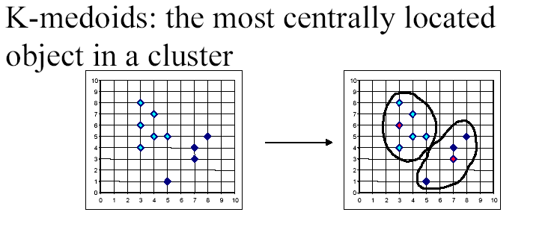
K-medoids
Notes:
Dr. Navneet Goyal, BITS,Pilani

Slide 69
PAM
Partitioning Around Medoids (PAM) (K-Medoids)
Handles outliers well.
Ordering of input does not impact results.
Does not scale well.
Each cluster represented by one item, called the medoid.
Initial set of k medoids randomly chosen
Notes:
Dr. Navneet Goyal, BITS,Pilani

Slide 70
PAM: Basic Strategy
First find a representative object (the medoid) for each cluster
Each remaining object is clustered with the medoid to which it is most “similar”
Iteratively replace one of the medoids by a non-medoid as long as the “quality” of the clustering is improved
Notes:
Dr. Navneet Goyal, BITS,Pilani

Slide 71
PAM: A K-medoids Method
Arbitrarily choose k objects as the initial medoids
Until no change, do
  (Re)assign each object to the cluster to which the nearest medoid
  Randomly select a non-medoid object o’, compute the total cost, S, of swapping medoid o with o’
  If S < 0 then swap o with o’ to form the new set of k medoids
Notes:
Dr. Navneet Goyal, BITS,Pilani

Slide 72
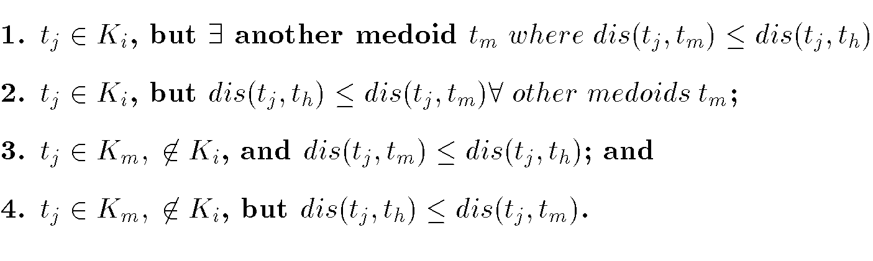
PAM Cost Calculation
At each step in algorithm, medoids are changed if the overall cost is improved.
C_{jih} – cost change for an item t_{j} associated with swapping medoid t_{i} with non-medoid t_{h}.
Notes:
Dr. Navneet Goyal, BITS,Pilani

Slide 73
PAM: Example
 | A | B | C | D | E
A | 0 | 1 | 2 | 2 | 3
B | 1 | 0 | 2 | 4 | 3
C | 2 | 2 | 0 | 1 | 5
D | 2 | 4 | 1 | 0 | 3
E | 3 | 3 | 5 | 3 | 0
Notes:
Dr. Navneet Goyal, BITS,Pilani

Slide 74
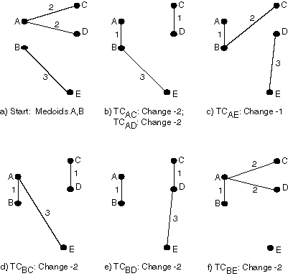
PAM
Notes:
Dr. Navneet Goyal, BITS,Pilani

Slide 75
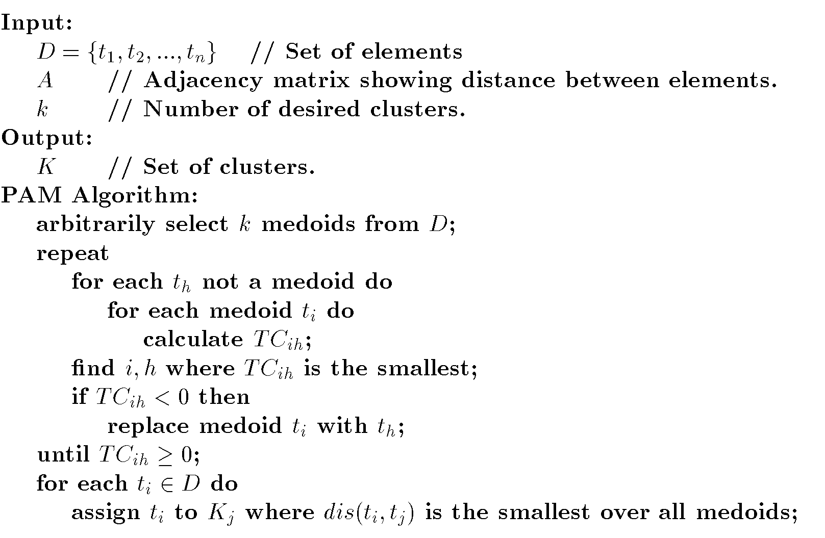
PAM Algorithm
Notes:
Dr. Navneet Goyal, BITS,Pilani

Slide 76
Pros & Cons of PAM
PAM is more robust than k-means in the presence of noise and outliers
Medoids are less influenced by outliers
PAM is efficiently for small data sets but
does not scale well for large data sets
O(k(n-k)2 ) for each iteration
Sampling based method: CLARA
Notes:
Dr. Navneet Goyal, BITS,Pilani

Slide 77
CLARA (Clustering Large Applications) (1990)
CLARA (Kaufmann and Rousseeuw in 1990)
  Built in statistical analysis packages, such as S+
It draws multiple samples of the data set, applies PAM on each sample, and gives the best clustering as the output
Strength: deals with larger data sets than PAM
Weakness:
  Efficiency depends on the sample size
  A good clustering based on samples will not necessarily represent a good clustering of the whole data set if the sample is biased
Notes:
Dr. Navneet Goyal, BITS,Pilani

Slide 78
CLARANS (“Randomized” CLARA) (1994)
CLARANS (A Clustering Algorithm based on Randomized Search) (Ng and Han’94)
CLARANS draws sample of neighbors dynamically
The clustering process can be presented as searching a graph where every node is a potential solution, that is, a set of k medoids
If the local optimum is found, CLARANS starts with new randomly selected node in search for a new local optimum
It is more efficient and scalable than both PAM and CLARA
Focusing techniques and spatial access structures may further improve its performance (Ester et al.’95)
Notes:
Dr. Navneet Goyal, BITS,Pilani

